Slide 1

Cross-Platform Mobile Application for Gaming Community

Slide 2
App development
Analysis & Research
Design, Plans & Methodology

Slide 3
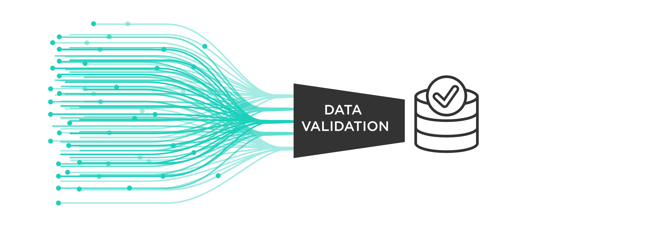
Learned
Importance of data validation
Flutter, Dart & State Management

Slide 4
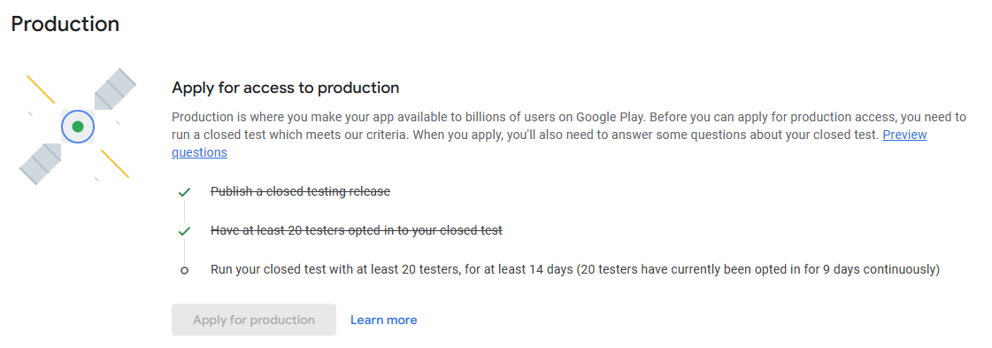

Key milestones
Developed a working product
Test users already leaving good reviews about it
Secure Back-end API server

Slide 5
Problems encountered
Push notifications
Application state management
Token validity check in Flutter
Mocha & Chai test environment
Time management

Slide 6
Future development
Push notifications
Reward system
CI/CD
Mark already equipped items*
Refresh market*
Instant sell*
A lot more but we’re out of time to discuss it
* Came from test users reviews

Slide 7
AI in Report
None
Turn it in gave me 5/100 and those 5 marks were from quoting myself from my own landing page

Slide 8
AI in Code
Minimal
Comparison with Google
UI/UX

Slide 9
Thank you for this opportunity!
Hopefully I’m on a right track to become a scarecrow engineer....outstanding in my field.
Any questions?

